Slide 1


TPS Equity Strategy:
The Road to Creating an Inclusive Workplace and Fairness in Community Safety
March 2024
Notes:
Svina

Slide 2

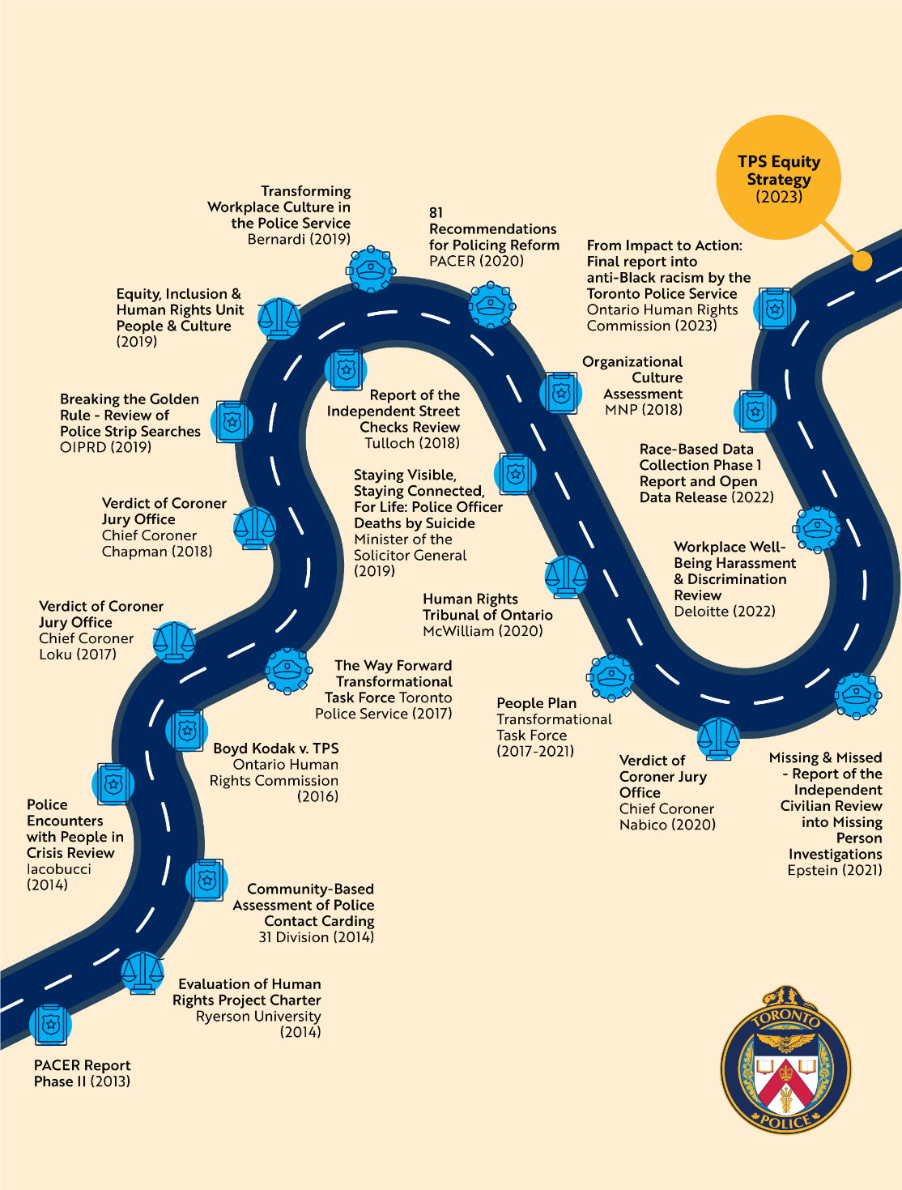
2
Our Why - Equity Strategy
Calls for action demanding change to our society and public sector institutions
Commit the Service to do the work needed and create accountability for driving systemic change toward fair and unbiased policing, and improving trust in and within the Service
Acknowledge our gaps and challenges, and take a proactive, progressive and collaborative approach
Develop one consistent Service-wide approach and strategy for our members and communities to work with and hold the Service accountable
Key Landmark Reports in the Last Decade
Notes:
Svina

Slide 3


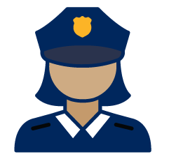



A thoughtful, evidence-based approach
that reflects the voices and experience of our communities and members
PAST REPORTS AND HISTORY
Over 20 reports and 1,100 recommendations have been considered
12 FOCUS GROUPS + 2 WORKPLACE SURVEYS
RBDC FINDINGS
COMMUNITY & STAKEHOLDER ENGAGEMENTS
surveys, town halls, engagement & consultation sessions
PARTNERSHIPS
e.g., Wellesley Institute, Mokwateh
BEST PRACTICES AND TEAM EXPERTISE
research, literature scans and reviews on existing & up-and-coming equity-based approaches, strategies, resources
Notes:
Svina

Slide 4
Community and Stakeholder Engagements Include…
Police and Community Engagement Review (PACER) Committee
Anti-Racism Advisory Panel (ARAP)
Missing & Missed Implementation Team (MMIT) – Community Group
Toronto Police Association (TPA)
The Association of Black Law Enforcers (ABLE)
Ontario Human Rights Commission (OHRC)
Serving with Pride
Mokwateh
Wellesley Institute
Confronting Anti-Black Racism (CABR) Unit
Bernardi Human Resource Law
Maple Leaf Sports Entertainment (MLSE) – EDI Team
TPS Internal Support Networks
Community Consultative Committees
RBDC Town Halls
Surveys (e.g., Annual Community Safety Surveys/Focus Groups, Chief Selection Survey/Public Consultations)
And more!
Notes:
Grace

Slide 5







The work is already underway (select highlights)…
Revised board policy on hiring and promotions
Implementing 81 Recommendations for Police Reform
Race and Identity-based Data Collection
Partnered with Gerstein Crisis Centre and Toronto Community Crisis Centre on call diversion
Revised 22+ Service Procedures through a newly revitalized Governance Equity Review process
Instituted mandatory anti-racism, Indigenous experience and gender diversity and trans inclusion training, taught by experienced civilian instructors
Published the Know Your Rights Campaign
Co-lead the provincial Working Group on Respectful Workplaces in Policing, and modernize complaints and investigative processes
Notes:
Grace

Slide 6
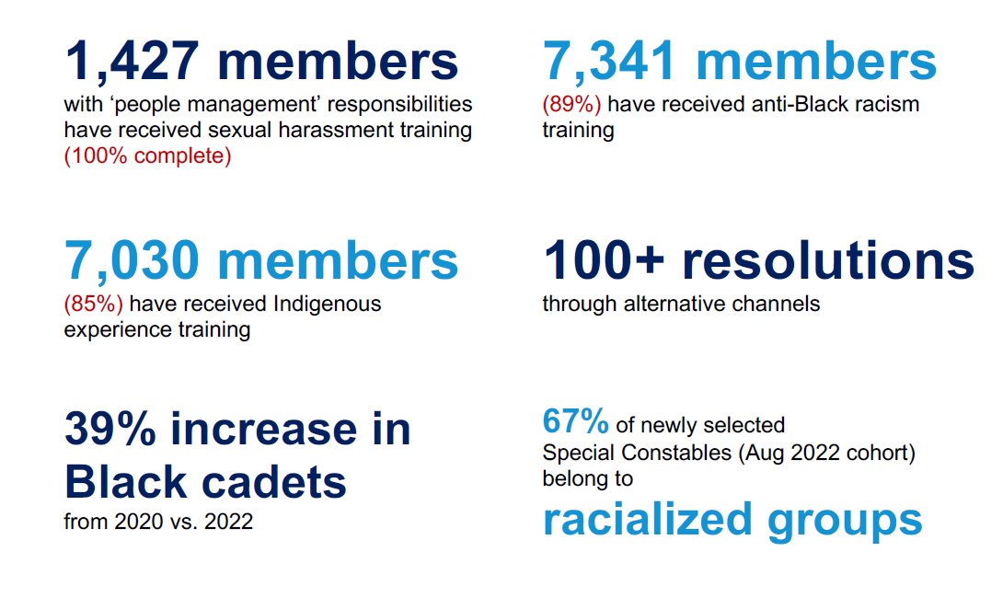
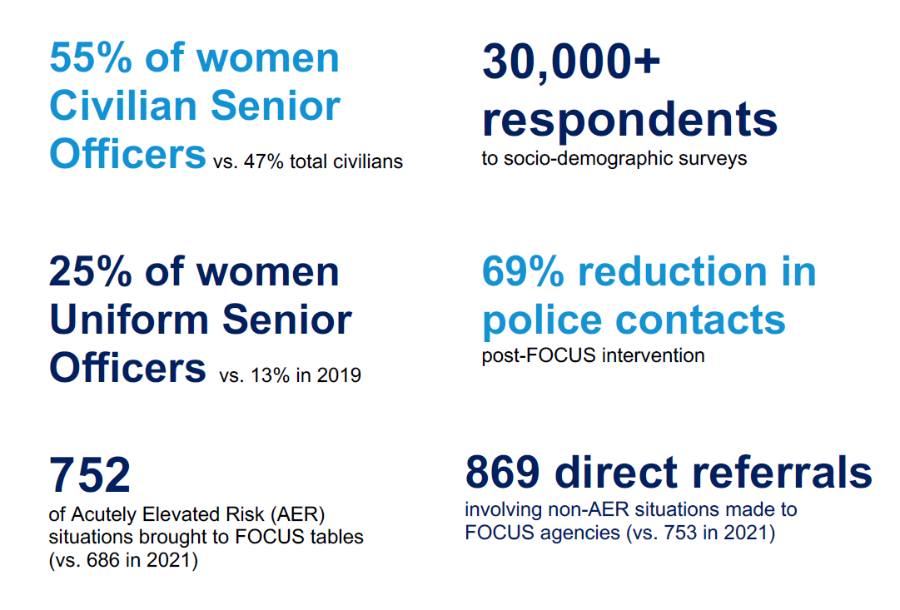
6
… and we are seeing some results
As of December 2022
Notes:
Grace

Slide 7
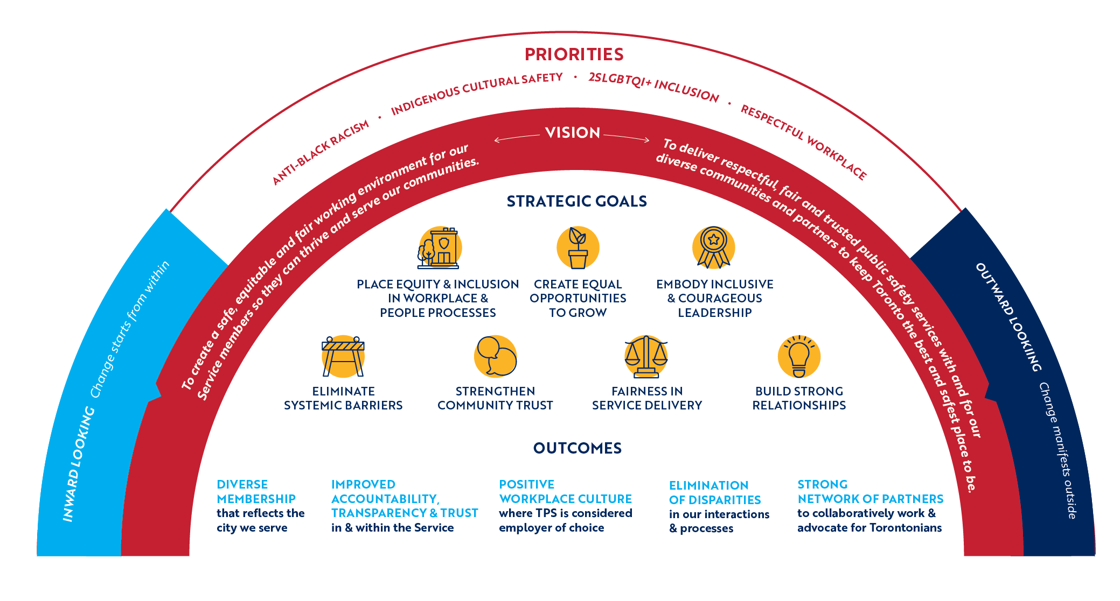
Anti-Racism, Inclusion and Workplace Culture
This strategy is both inward facing – for Service members – and outward facing – for the public and communities we serve
Notes:
Grace

Slide 8
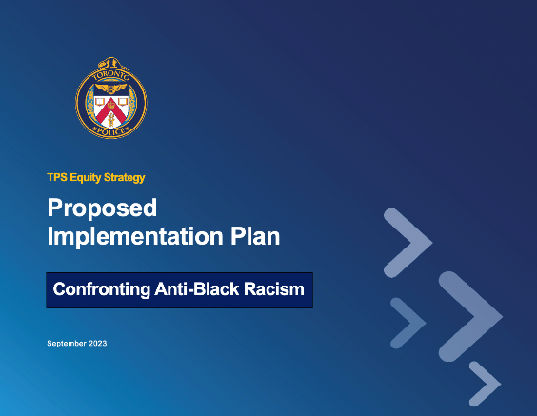
From Strategy to Action
A living plan that is influenced and informed by historical and current challenges faced by the Service
Priority-specific
IMPLEMENTATION PLANS
OVERALL STRATEGIC FRAMEWORK
Message from the Board
Message from the Command
Land Acknowledgement
Contribution of Black Communities
Working with 2SLGBTQI+ Communities
Introduction: TPS Equity Strategy
Moving Forward: Our Strategic Framework
Implementation Approach
Appendices
Acknowledgements
Confronting Anti-Black Racism
Indigenous Cultural Safety
Fostering 2SLGBTQI+ Inclusion
Cultivating a Respectful Workplace
Notes:
Grace

Slide 9

Organization-wide actions to drive change
Implementation Plans and Actions span 20 Program Areas
HR PROGRAMS & PROCESS
Develop HR programming that allows members to reach full potential and understand gaps (e.g., career pathing, 360 review)
Recruitment, hiring and promotional process review
Incorporate equity lens into competencies and performance management
TRAINING & PROFESSIONAL DEVELOPMENT
Develop, augment and review equity and scenario–based training
Create, enhance and increase access to leadership and professional development opportunities and resources
Co-develop and co-deliver immersive community experience programs

Slide 10
Organization-wide actions to drive change
INTERNAL ENGAGEMENT & SUPPORT
Greater internal engagement and augmenting the role of ISNs
Incorporate inclusive and culturally sensitive wellness supports and resources
Transparency and accountability through internal and external communications
CREATING A RESPECTFUL AND EQUITABLE WORKPLACE
Development and enhancement of norms, policies and procedures around civility and respectful and equitable workplace
Modernized a victim-centered approach towards complaints, investigations, harassment and resolution processes, and comply with legislative requirements
Public acknowledgement of recognizing Indigenous peoples and the land we live on, and their historical and current relationship with the justice system

Slide 11
Organization-wide actions to drive change
DATA COLLECTION, ANALYSIS & EVALUATION
Collect and analyze internal and external race and identity-based data collection
Develop monitoring, evaluation and surveying capacities of Service programs and service delivery
COMMUNITY ENGAGEMENT AND COLLABORATIONS
Ongoing community engagement and consultations with
co-design/co-develop mindset
Closer alignment and collaboration between units with mandates around fostering equity and community relationships
Greater public education/
advocacy, partnerships and multi-sector collaborations
COMMUNITY SAFETY AND EQUITY IN POLICING
Community safety and well-being centered models and programs
Augment supervisory capacity and leadership capability and responsibilities among leaders
Embed equity and inclusion lens into policing operations, procedures, practices and planning

Slide 12
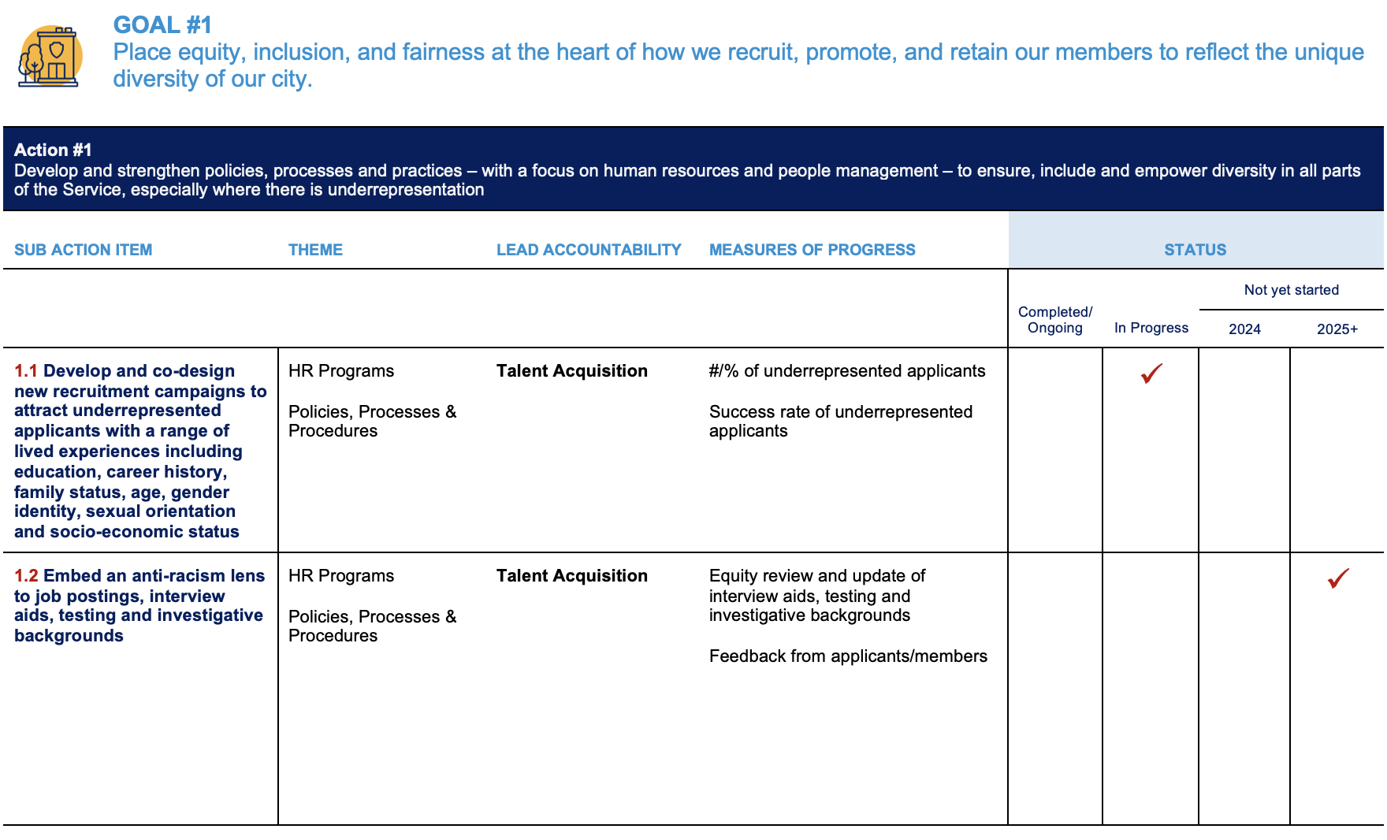
Bringing it all together
A long-term implementation plan that is tactically focused on 24 – 36 month timelines
Notes:
Grace

Slide 13
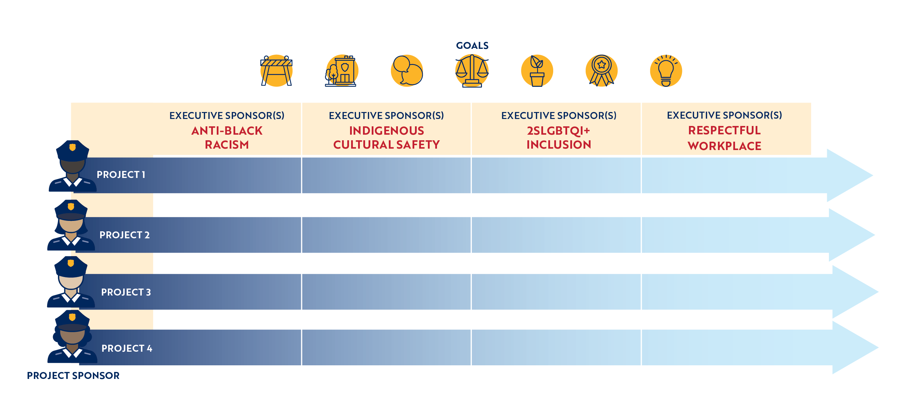
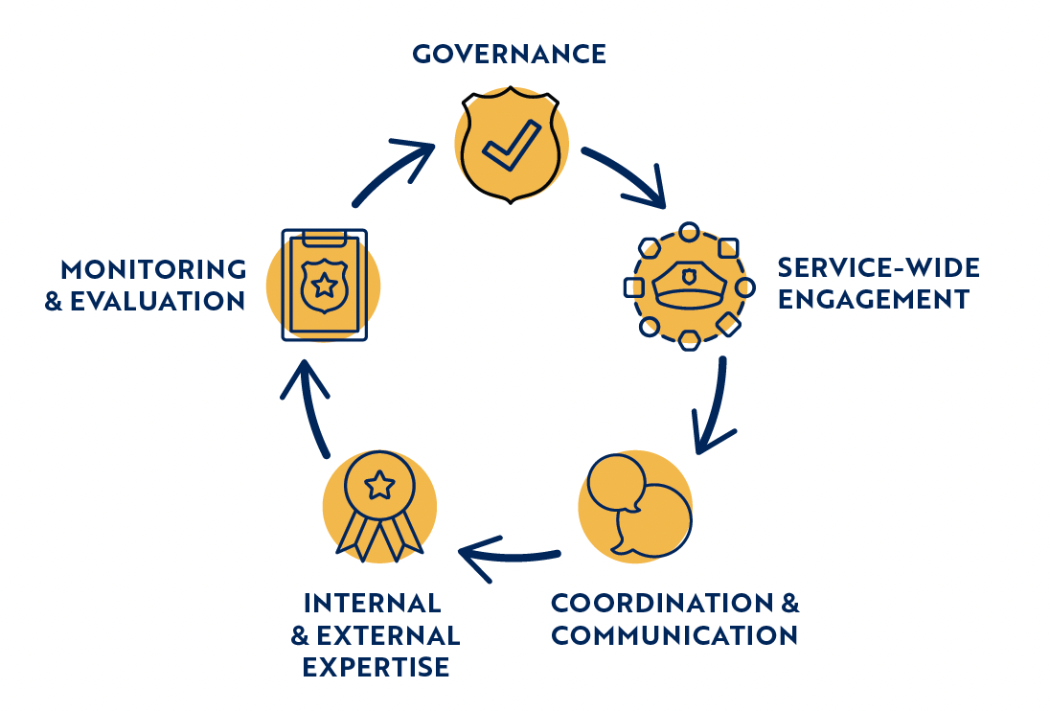
Co-Design, Co-Develop, Co-Deliver…
With community, our members and priority areas at the centre
Notes:
Svina

Slide 14

Thank you.
Questions?
http://tps.to/equity-strategy
CONTACT US
CAO Svina Dhaliwal
Equity Strategy Executive Sponsor
equityinclusion@torontopolice.on.ca
Grace Ryu, PhD
Equity Strategy Lead
Notes:
Svina

